Slide 1
Summary of British Airways Customer Review Analysis
Insights from 1000 Customer Reviews

Slide 2
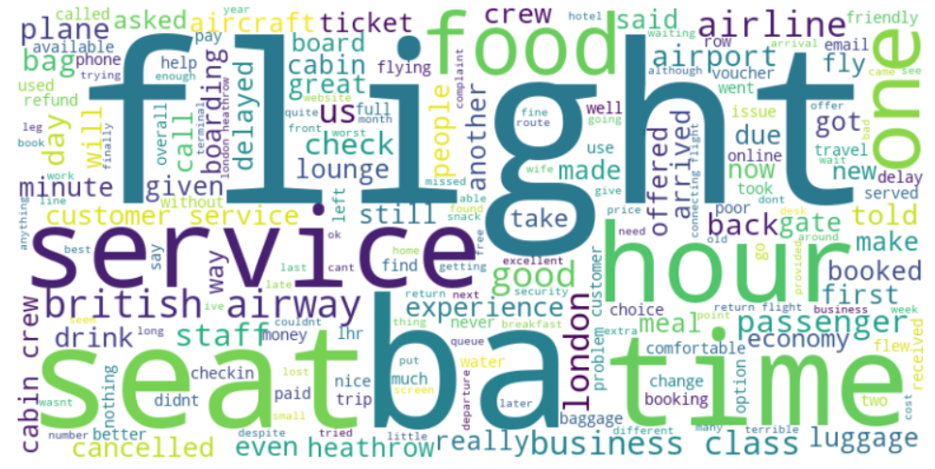
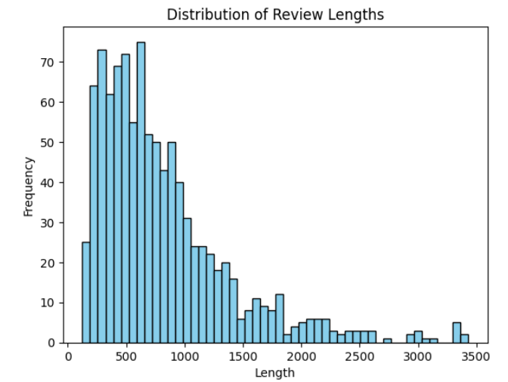
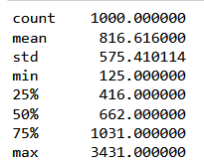
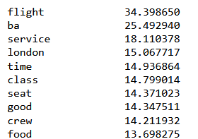

Insights from 1000 Customer Reviews
Majority of reviews are positive (619 out of 1000)
Common topics include 'flight', 'service', 'seat', 'time', and 'food’
Frequent mentions of 'BA' and 'British Airways' indicate brand loyalty or recognition
Actionable Recommendations
Focus on improving customer service and seating comfort to address negative feedback
Leverage positive reviews in marketing campaigns to highlight customer satisfaction
No. of reviews analyzed
Top 10 Frequent topics
Sentiment Analysis

